Slide 1
Hebrew Civilization
SSWH1 Analyze the origins, structures, and interactions of societies in the ancient world from 3500 BCE/BC to 500 BCE/BC.
c. Explain the development of monotheism, include: the concepts developed by the ancient Hebrews.

Slide 2
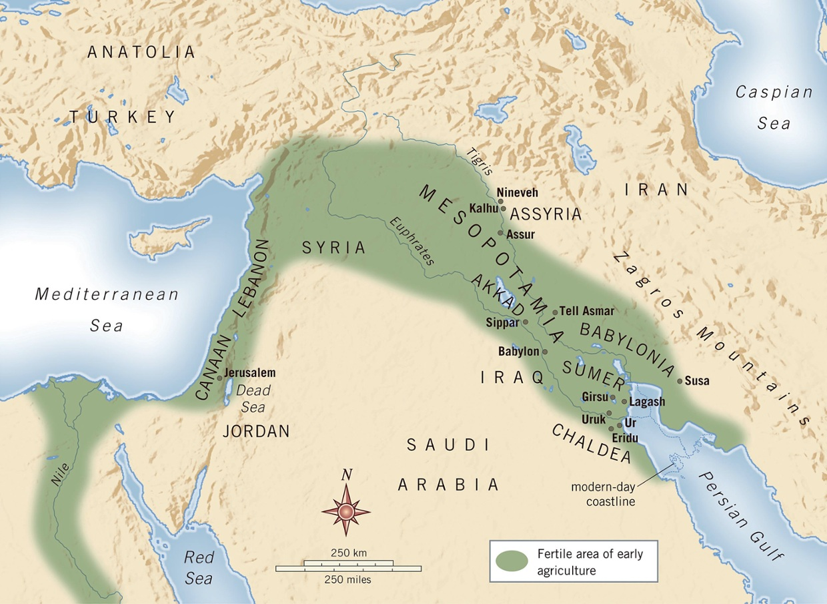

Slide 3
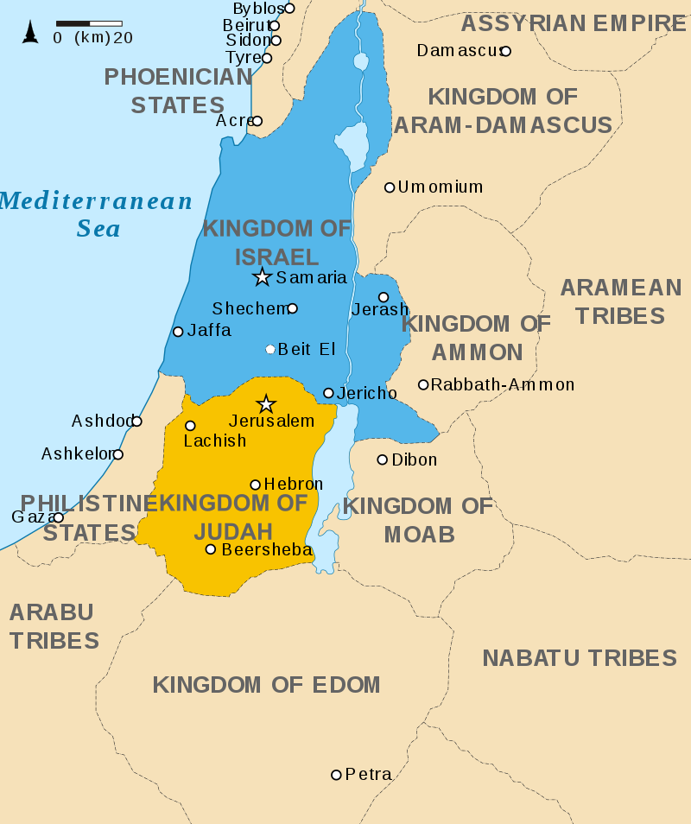

Slide 4
The Hebrews
2000 BC—Hebrew (Jewish) civilization arose just South of Phoenicia
In a region called Canaan
Established by Abraham because God spoke to him
“Father of the Israelites”
Present day: Israel, Lebanon, and Jordan
Greatly influenced by both Mesopotamia and Egypt
Judaism: ancient Hebrew religion
SSWH1 Analyze the origins, structures, and interactions of societies in the ancient world from 3500 BCE/BC to 500 BCE/BC.
c. Explain the development of monotheism, include: the concepts developed by the ancient Hebrews.
Notes:
Israelites believe in God’s covenant (promise) to Abraham
You shall be the father of a multitude of nations…..I will make nations of you, and kings shall come forth from you. And I will establish my covenant between me and you and your descendants after you throughout their generations for an everlasting covenant, to be God to you and to your descendants after you. And I will give to you, and to your descendants after you, the land of your sojournings (short stay), all the land of Canaan… ---Genesis 17:4-8
Israelites believed Canaan to be their “promised land” because of God’s covenant.

Slide 5
Key features of Judaism
Other civilizations were polytheistic and animists
Hebrews: monotheistic—became the basis for Christianity and Islam
Hebrews relationship with God is told in first books of the Christian Bible
Old Testament: Genesis, Exodus, Leviticus, Deuteronomy, Numbers
What Jews refer to as the Torah
10 Commandments, which Hebrews believed were given to Moses by God
Forbade immoral conduct as stealing and murder
SSWH1 Analyze the origins, structures, and interactions of societies in the ancient world from 3500 BCE/BC to 500 BCE/BC.
c. Explain the development of monotheism, include: the concepts developed by the ancient Hebrews.
Notes:
Israelites were a patriarchal society.
Law was central to the Israelites way of life. They believed the Commandments were given through Moses as a set of Laws to live by.

Slide 6
The Exodus
1600BC ancient Hebrews migrated to Egypt
To escape food shortages (famine)
Remained in Egypt for hundreds of years
Enslaved by Egyptians
Led out of Egypt by Moses back to Canaan
God gave Moses 10 Commandments
SSWH1 Analyze the origins, structures, and interactions of societies in the ancient world from 3500 BCE/BC to 500 BCE/BC.
c. Explain the development of monotheism, include: the concepts developed by the ancient Hebrews.
Notes:
Moses tells the Israelites that in return for their faithful obedience to God, God will lead them out of bondage (slavery) in Egypt and into the promised land.
Moses lead the Israelites in their exodus from Egypt, from slavery to freedom. The journey took 40 years to reach Canaan, but Moses died before they arrived.

Slide 7
The Diaspora
Diaspora: dispersion
1000BC: Hebrews returned to Israel
Occupied by Philistines
Led to series of Wars
Hebrews re-conquered Israel
Jerusalem—Capital
Erected a temple to God
Conquered by Assyrians, Greeks, and Romans
Rebelled against the Romans
Destroyed their temple at Jerusalem
Large numbers of Jews fled to Europe, Asia, and Africa
SSWH1 Analyze the origins, structures, and interactions of societies in the ancient world from 3500 BCE/BC to 500 BCE/BC.
c. Explain the development of monotheism, include: the concepts developed by the ancient Hebrews.
Notes:
1000BC: 12 tribes of Israel not united. Saul the 1st King of Israel untied the tribes into a single nation.
King David—the second king—establish Jerusalem as its national capital. Solomon, son of David, built a Temple dedicated to God. With Solomon’s death in approximately 922 BC the kingdom split into Israel in the North and Judah in the South.
Israelites from the Kingdom of Judah became known as the Jews.

